Slide 1


Oslo Xamarin Meetup
Smarter apps with Artificial Intelligence (AI)
By Monica B. Tvedt, 13.12.2018

Slide 2
Agenda
Workshop: Building smarter apps with Artificial Intelligence (AI) Level: Beginner
Introduction to AI and Azure Cognitive Services
Coffe Break
Hands-on Workshop
Emotion Recognition
Xamarin.Forms
Innovation Hour

Slide 3
MONICA B. TVEDT, AVDELINGSLEDER
For Sopra Steria sin Microsoft .NET avdeling og deres DevOps & Microservices avdeling
TIDLIGERE
Head of UMS Innovation center at Unified Messaging Systems ASA
Head of SaaS Development at Unified Messaging Systems ASA
Senior Software Engineer Consultant, Webstep AS
Software Engineer, Cellvision AS
Gründer
UTDANNELSE
Boston University Business & Management, Digital Leadership Business & Management, Digital Product Management
University of Bergen & Bergen University College Dataingeniør, Master Software Engineering - CERN
ARTIKLER & INTERVJUER
Thinking big – while covering the smaller needs
Små partikler – Store datamengder Dagens Næringsliv
App development, Xamarin Test Cloud & Continuous Integration
ANDRE ROLLER
Microsoft .NET Meetup Owner at Sopra Steria, Oslo Xamarin Meetup Organizer, Bergen Xamarin Meetup Organizer, Investing & Trading Community Owner at Sopra Steria
INTERESSER/AKTIVITETER
Sjakk, tennis og programmering

Slide 4
AI + Machine Learning
It starts with Neural Networks
Machine learning is the computing paradigm that’s lead to the growth of AI. It’s based on the development of neural networks and deep learning. A neural network transitions into the realm of machine learning once a corrective feedback loop is introduced.
Stanford University defines machine learning as “the science of getting computers to act without being explicitly programmed”
AI is when you design an intelligent agent that also perceives its environment and makes decisions to maximize chances of achieving its goal, thereby mimicking human behavior.

Slide 5
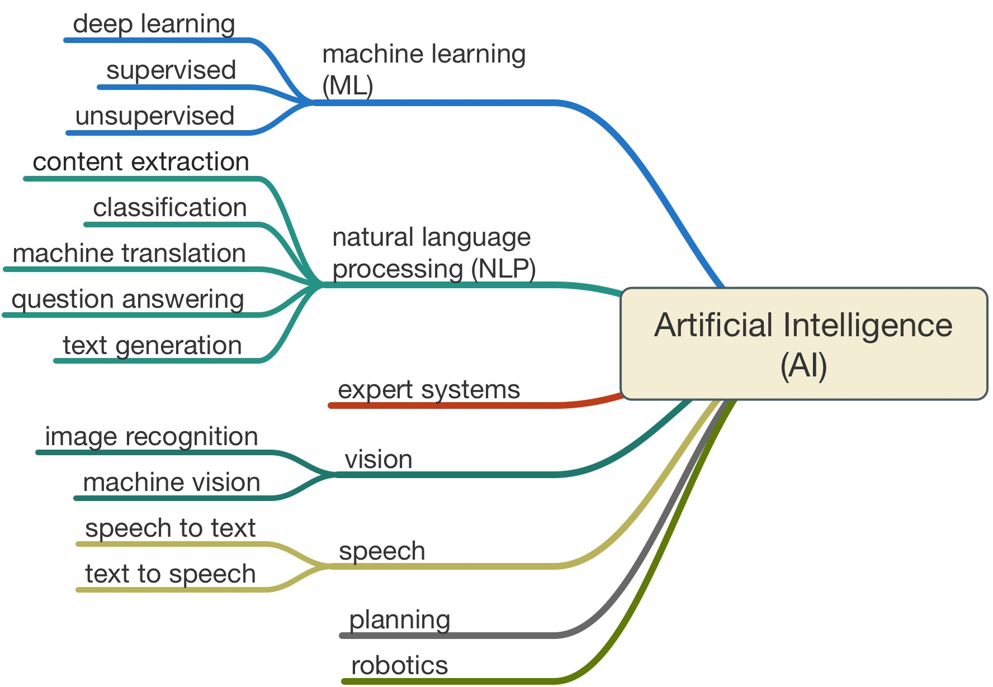

Slide 6

AI Services in Azure

Slide 7
Azure Cognitive Services are a set of APIs, SDKs and services available to developers to make their applications more intelligent, engaging and discoverable.
Notes:
Microsoft Cognitive Services expands on Microsoft’s evolving portfolio of machine learning APIs and enables developers to easily add intelligent features – such as emotion and video detection; facial, speech and vision recognition; and speech and language understanding – into their applications. Our vision is for more personal computing experiences and enhanced productivity aided by systems that increasingly can see, hear, speak, understand and even begin to reason.
Microsoft Cognitive Services let you build apps with powerful algorithms using just a few lines of code. They work across devices and platforms such as iOS, Android, and Windows, keep improving, and are easy to set up.

Slide 8
Snapchat
Notes:
It all started with SnapChat and my phone taking bad pictures – so I developed my own camera-app with better coloring and face-mesh to adjust to different filters, as SnapChat. I used the early versions of Microsofts Cognitive Services which has by fare gotten much better since then.
In need of more algorithms and manual calculations before -> now it is all done for you.

Slide 9
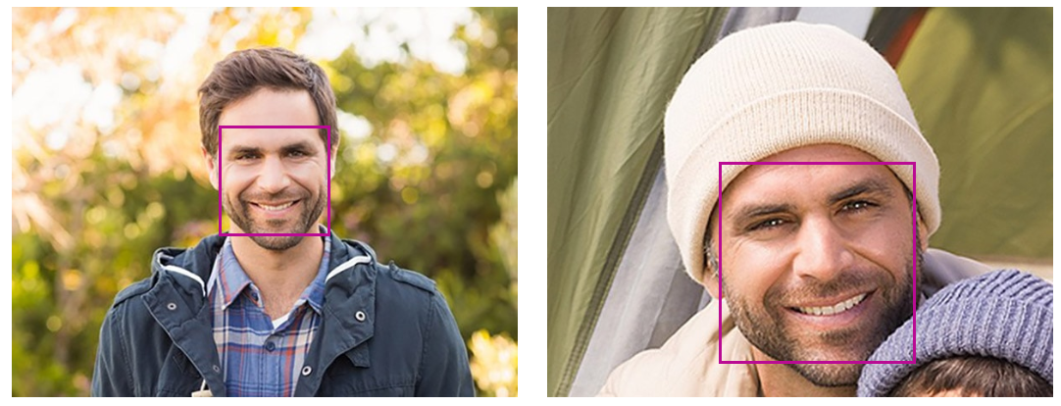
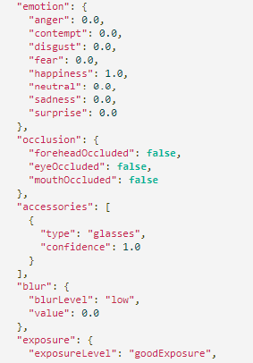
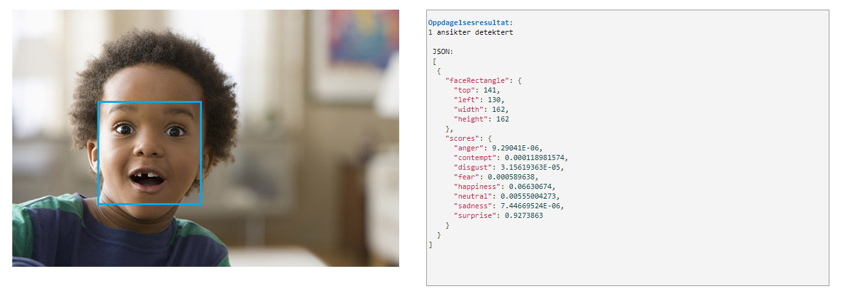
Azure – Cognitive Services, Face API

Slide 10
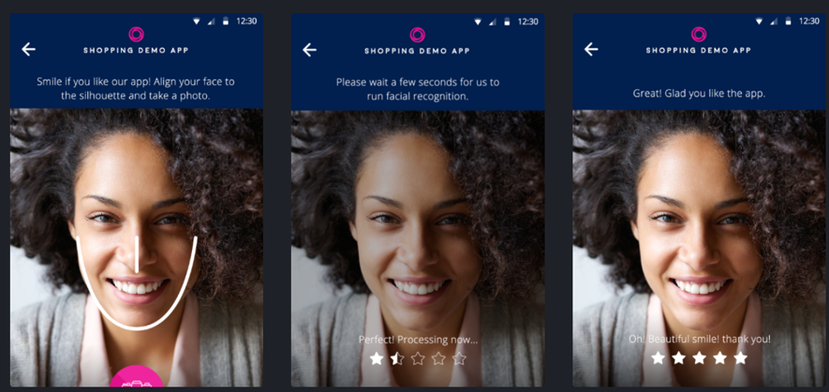
Using Emotions
https://azure.microsoft.com/nb-no/services/cognitive-services/face/

Slide 11
Azure – Cognitive Services
Sign up for Microsoft Azure
You need an Azure account to complete this tutorial. You can:
Open an Azure account for free. You get credits that can be used to try out paid Azure services. Even after the credits are used up, you can keep the account and use free Azure services and features, such as the Web Apps feature in Azure App Service.
Activate Visual Studio subscriber benefits. Your Visual Studio subscription gives you credits every month that you can use for paid Azure services.
Get credits every month by joining to Visual Studio Dev Essentials.
Face API
You need to subscribe to the Face API to get an API key and endpoint-URI which we will use in our app.
Search for “Cognitive Services” in the Azure Portal, click “Add”, Find the Face API under “Cognitive Services”

Slide 12
Workshop: Creating our initial App
Create a new Xamarin.Forms project named «XamAI»
From top menu in Visual Studio: File > New > Project
Select «installed» > «Visual C#» > «Cross-Platform» > «Mobile App (Xamarin.Forms)»
Define the project name and solution name befor clicking «OK»
Next, select the template «Blank» and choose your platforms (iOS and/or Android). Code sharing strategy is set to .NET standard.
Click «OK» and your project will be created.
Find the CPL for this app on GitHub: https://github.com/StargrrlMoonlight/Oslo-Xamarin-Meetup

Slide 13
Workshop: Install NuGet Packages
We will use the following NuGet packages:
Newtonsoft.Json – provides a JSON framework for .NET.
PCLStorage – provides a set of cross-platform local file IO APIs.
sqlite-net-pcl – provides SQLite database storage.
Xam.Plugin.Media – provides cross-platform photo taking and picking APIs.
In addition, these NuGet packages also install their own dependencies.

Slide 14
Workshop: Creating our Main Startup Page
Remove the MainPage.Xaml page
Open App.xaml code-behind-file and change: «MainPage = new MainPage();» to «MainPage = new NavigationPage(new TodoListPage());» and add «using XamAI.Views;» at the top.
Add the following folders: Views, Services, Repositories, Models
Create a new content Xaml page «TodoListPage» and place it inside the «Views» folder.
Run the App to verify

Slide 15
Workshop: Creating our Layout
Adding our Toolbar with click events and belonging icons in our Drawable-folder inside XamAi.Android Resources and XamAI.iOS Resources: <ContentPage … > <ContentPage.ToolbarItems> <ToolbarItem Icon="plus.png" Clicked="OnItemAdded" /> <ToolbarItem Icon="rating.png" Clicked="OnRateApplication" />
</ContentPage.ToolbarItems>
<ContentPage.Content> … </ContentPage.Content>
</ContentPage>
//Assets can be found at github: https://github.com/StargrrlMoonlight/Oslo-Xamarin-Meetup

Slide 16
Workshop: Handle our OnRateApplication event
Create a new content Xaml page «RateAppPage» and place it inside the «Views» folder.
Open our code-behind file, TodoListPage.xaml, and add: async void OnItemAdded(object sender, EventArgs e){ //todo }
async void OnRateApplication(object sender, EventArgs e){
await Navigation.PushAsync(new RateAppPage()); }

Slide 17
Workshop: Create our RateAppPage Layout
Replace the current label with the following layout:
<Button Text="Take Photo and Analyze" Clicked="OnTakePhotoButtonClicked" />
<Image x:Name="image" />
<ActivityIndicator x:Name="activityIndicator" />
<StackLayout Orientation="Horizontal" HorizontalOptions="CenterAndExpand">
<Label Text="Emotion:" />
<Label x:Name="emotionResultLabel" />
</StackLayout>
Ad the following method in the belonging code-behind file:
async void OnTakePhotoButtonClicked(object sender, EventArgs e){ }

Slide 18
Workshop: Taking a picture
RateAppPage Code-behind, add the following:
using Plugin.Media;
using Plugin.Media.Abstractions;
And add the class variable: MediaFile photo;
Inside the our new method: await CrossMedia.Current.Initialize(); if(CrossMedia.Current.IsCameraAvailable ||CrossMedia.Current.IsTakePhotoSupported){ } else {
await DisplayAlert("No Camera", "Camera unavailable.", "OK");
}

Slide 19
Workshop: Taking the actual picture
photo = await CrossMedia.Current.TakePhotoAsync(new StoreCameraMediaOptions
{
Name = "emotion.jpg",
PhotoSize = PhotoSize.Small
});
if (photo != null)
{
image.Source = ImageSource.FromStream(photo.GetStream);
}

Slide 20
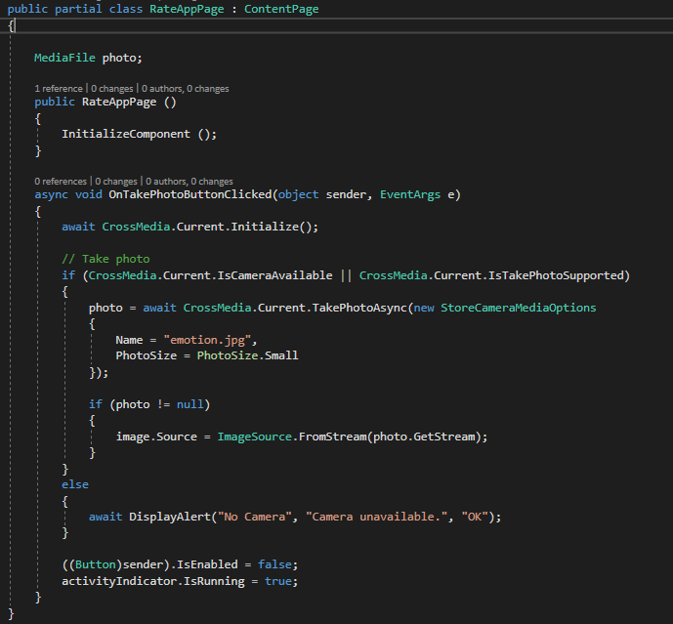
Workshop: Taking a picture, complete code

Slide 21
Task 1: How to use a local image instead of the camera

Slide 22
Task 2: How to select an image from camera roll

Slide 23
Workshop: adding our API keys
Create a new file «Constants.cs» in our project root folder and add our API keys and endpoints
Remember to check if the right region is stated.

Slide 24
Workshop: Recognize emotions
Create a new folder «Face» inside our Models-folder.
Add our Models
Create IFaceRecognitionService.cs and our FaceRecognitionService.cs, complete files is found online.
In our RateAppPage code-behind, create a reference to our new service: IFaceRecognitionService _faceRecognitionService;
Remember to Initialize it: _faceRecognitionService = new FaceRecognitionService();

Slide 25
Recognizing emotions at our captured image!

Slide 26
RateAppPage.xaml -> OnTakenPhotoButtonClicked
// Recognize emotion
try
{
if (photo != null)
{
}
} catch (Exception ex)
{
Debug.WriteLine(ex.Message);
}

Slide 27
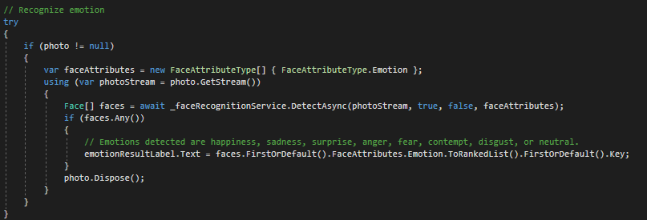
RateAppPage.xaml -> OnTakenPhotoButtonClicked

Slide 28
Task 3: Inspect our Face API response & try to get more Attributes, ie. Age

Slide 29
Innovation Hour

Slide 30


Slide 31
Thanks for watching
www.soprasteria.no

